Slide 1
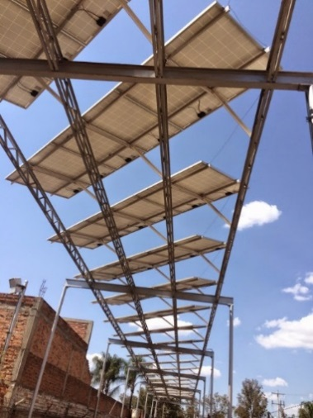
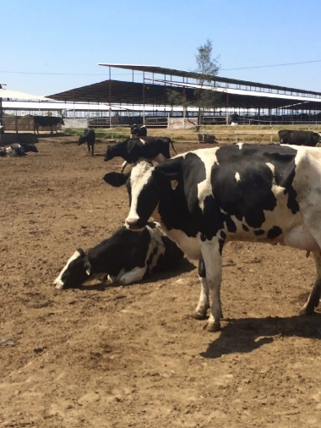
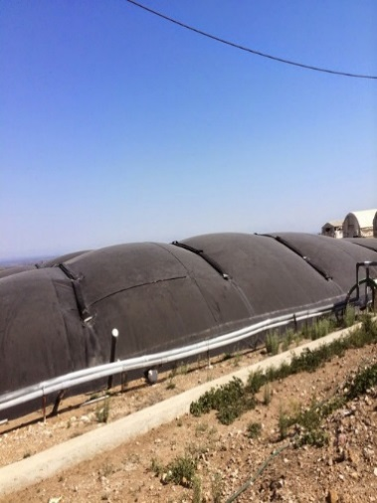
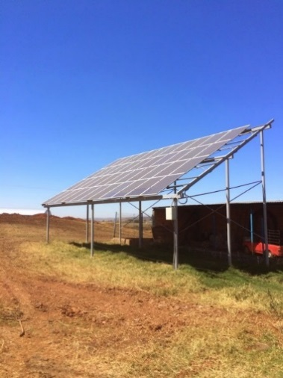
Energizing Agriculture
The Case of Data and Biovalor in Uruguay
Katie Kennedy Freeman, Senior Agriculture Economist

Slide 2
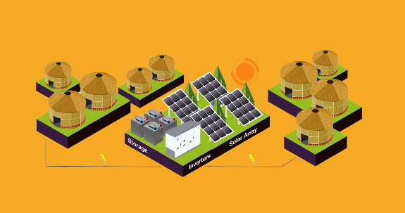
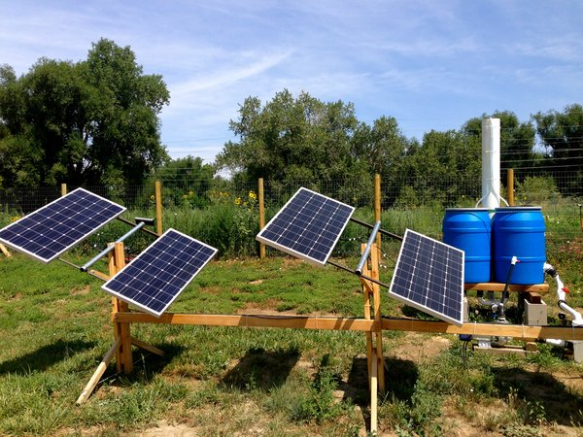
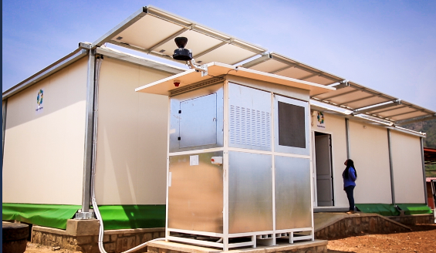
Widespread phone access enabled…
From Energy…
2008:
Pay-as-you-go Home Solar Systems
2018: “pay as you chill” models for cold storage
…to Agriculture
2012: solar irrigation with remote monitoring of water pumping

Slide 3
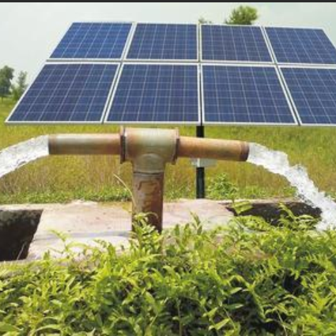
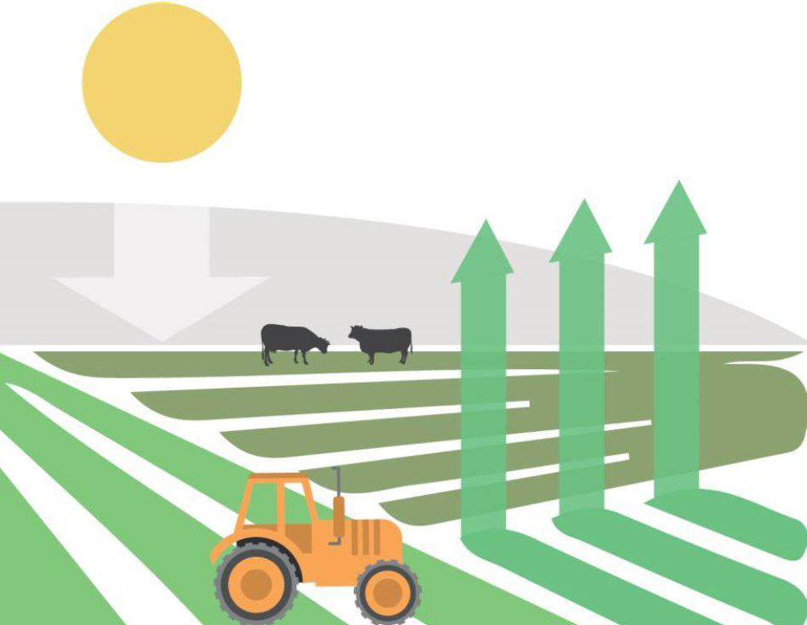
Access
Cost
GHG emissions from Agriculture
Notes:
In Africa and parts of south Asia, we are concerned with Access. We have programs in Uganda and Nigeria to expand access.
In other places, like LAC where access is high, we talk more about COST and GHG emissions.

Slide 4
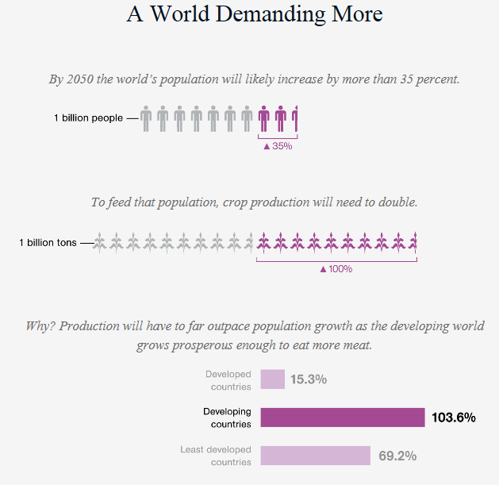
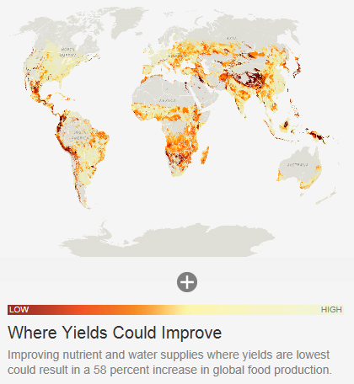
Globally, farmers face growing global food demand and associated input needs
Global food demand is growing
Growing agribusinesses increasingly need energy and water for irrigation, production and processing
National Geographic, The Future of Food, 2015
National Geographic, The Future of Food, 2015
Notes:
In LAC, A growing middle class is demanding a better diet and growing economies increasingly depend on Ag exports.
Demand is projected to rise for rice, feed grains, poultry, dairy, vegetable oils, horticulture, and processed foods for import substitution, along with the traditional tropical exports and their derived products (especially cocoa, rubber, cashews, and palm oil), together with some higher-value horticultural crops, fish, and biofuels for export.
At the same time, Overall LAC has high access to electricity, but there are large disparities in electricity access rates and affordability both between and within countries in the LAC region.
LAC hosts an estimated 34 million people in the region without access to electricity, and more without reliable electricity.
In countries where electricity is largely available, electricity is expensive and the growth of agribusiness is hindered by electricity costs and GHG emissions are high.

Slide 5
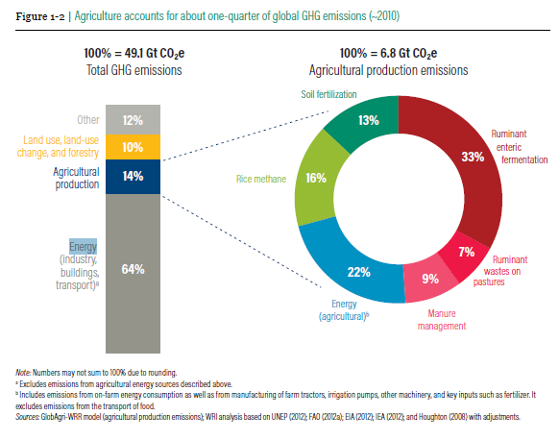
Energy’s contribution to Agriculture GHG is significant…
=
WRI 2018 Creating a Sustainable Food Future
Notes:
Energy used in agriculture provides both a challenge and an opportunity. As an input, energy comprises a significant amount of agriculture’s contribution to Green House Gas (GHG) emissions. Energy used for agriculture (including on-farm consumption as well as energy from manufacturing of farm equipment and key inputs like fertilizer) comprises 22% of the total emissions from the agriculture sector. This is even before considering emissions from transportation of food. (WRI 2018). However, new technology in the energy sector, including solar and energy efficient appliances, provide an opportunity for new cleaner systems of agriculture production and significant reductions in GHG emissions.
The agriculture / energy relationship goes beyond just that of energy inputs into agriculture. Agriculture residues can also be converted into feedstock for clean energy systems, thereby powering appliances with agriculture waste, increasing energy access and creating on-farm circular economies of efficiency. Ruminant wastes on pastures and manure management together comprise a total of 16% of agriculture’s contribution to GHG (WRI 2018). The installation of simple technologies – such as on-farm biodigesters – has the potential to simultaneously improve manure management, reduce GHG emissions and produce energy on-farm.

Slide 6
Uruguay’s Agenda 2030
How to feed 50 million people by 2030?
Notes:
The Government of Uruguay (GoU) has a goal of increasing the quantity and quality of its agricultural exports to feed 50 million people by 2030 and has put in place ambitious policies to help meet this goal, including that of sustainable intensification. The GoU's commitment to sustainability is in part driven by the desire to support continued growth while maintaining and enhancing the productivity of its natural resources (water, soil, biodiversity) into the future. For the agri-food sector specifically, the principle of Sustainable Intensification is at the core of GoU strategic priorities. The production of high-quality products has allowed Uruguay to access high-value and differentiated markets in North America, East Asia and Western Europe, but implies intensive resource use and risks to soil, water, human health and biodiversity. Within this context, the challenge becomes how to enhance innovation to reconcile high demand with a low overall agricultural footprint (including GHG) under principles of circular economy.
Uruguay has a population of 3.5 million people, so the goal will represent feeding more than 14 times the Uruguayan population.

Slide 7
Increasing volume, access to differentiated markets
Notes:
The GoU's commitment to sustainability is in part driven by the desire to support continued growth while maintaining and enhancing the productivity of its natural resources (water, soil, biodiversity) into the future. For the agri-food sector specifically, the principle of Sustainable Intensification is at the core of GoU strategic priorities. The production of high-quality products has allowed Uruguay to access high-value and differentiated markets in North America, East Asia and Western Europe, but implies intensive resource use and risks to soil, water, human health and biodiversity. Within this context, the challenge becomes how to enhance innovation to reconcile high demand with a low overall agricultural footprint (including GHG) under principles of circular economy.
Uruguay has a population of 3.5 million people, so the goal will represent feeding more than 14 times the Uruguayan population.

Slide 8
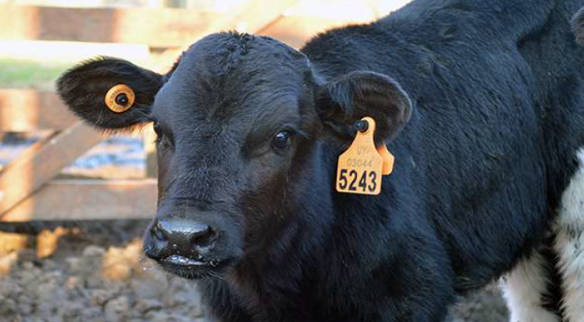
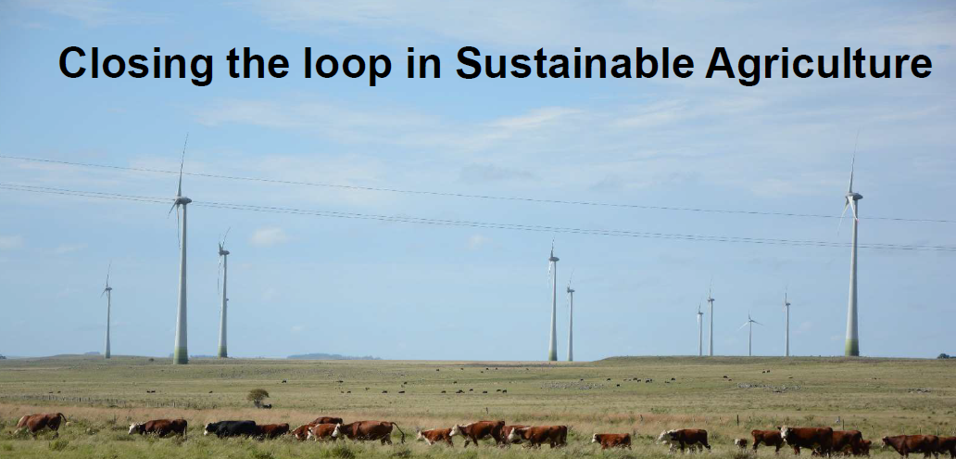
Sustainable Intensification includes:
Sustainable water use
Sustainable land use
Information systems for monitoring and better decision making
Energy sustainability under the principles of circular economies.

Slide 9
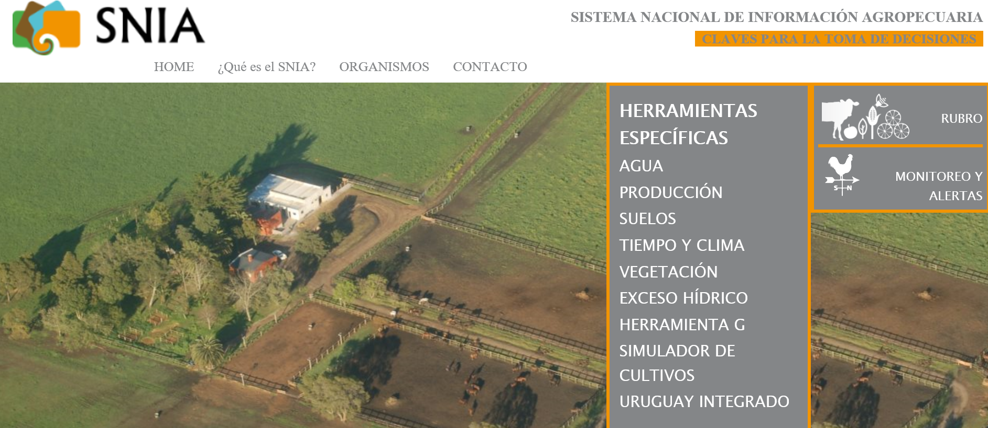
SNIA

Slide 10
Mapping and protection of soil and water

Slide 11
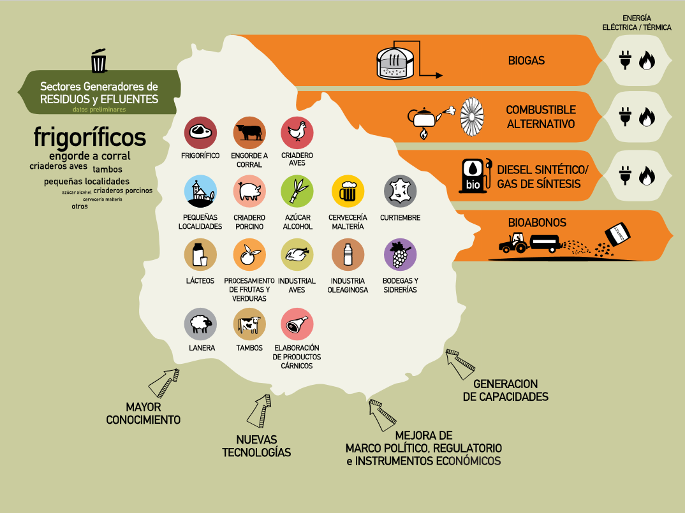
Uruguay’s Biovalor project
Notes:
In 2015, over 90% of its electrical energy and over 50% of the primary-source energy mix generated came from renewable sources

Slide 12
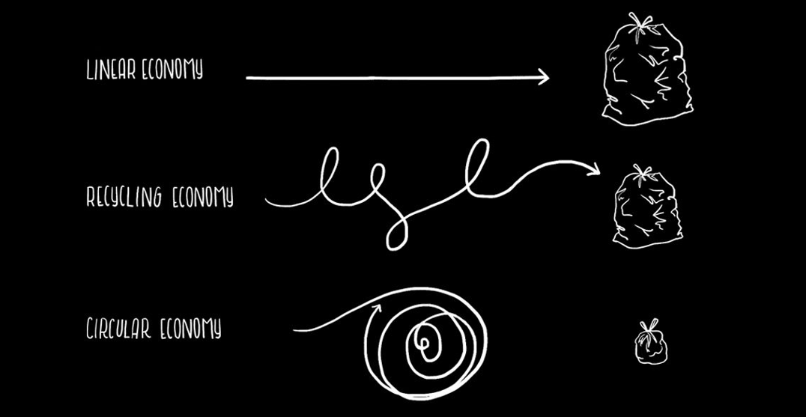
Energy providing value to Agriculture
Notes:
Uruguay has developed a series of strategies and has taken consistent steps to improve citizen livelihood with a clear view to transitioning into a green economy through innovation, technology and the adoption of specific public policies, namely:
- The Uruguayan energy grid has become a highly renewable-energy matrix. In 2015, over 90% of its electrical energy and over 50% of the primary-source energy mix generated came from renewable sources while during the 2001-2006 period, 60% of energy sources had to be imported.
- The Biovalor Project (which leads the organization of this forum) an initiative of the Uruguayan Government implemented through three of its Ministries (Ministry of Industry, Energy and Mining - MIEM, Ministry of Livestock, Agriculture and Fisheries - MGAP, and Ministry of Housing, Land Use Management and Environment - MVOTMA) seeks to promote waste recovery in national agribusiness industries. From the outset, the project was approached from a circular economy perspective and was geared to finding sustainable business models to transform waste into raw material for new production processes.

Slide 13
Annex: Bonus Case Study: Energy for Agriculture in Mexico

Slide 14
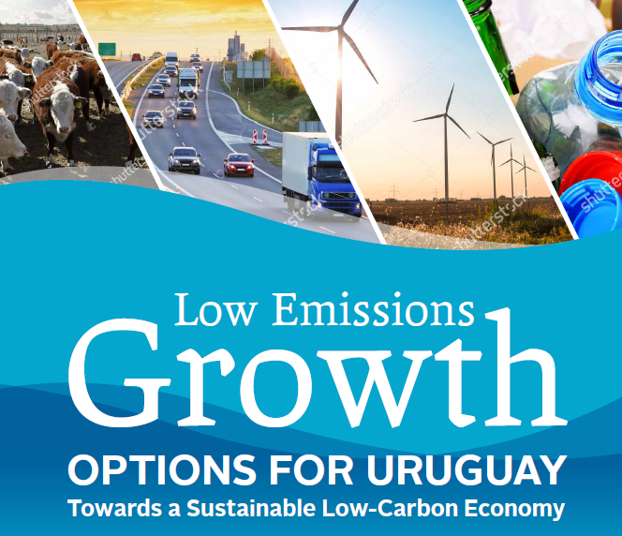
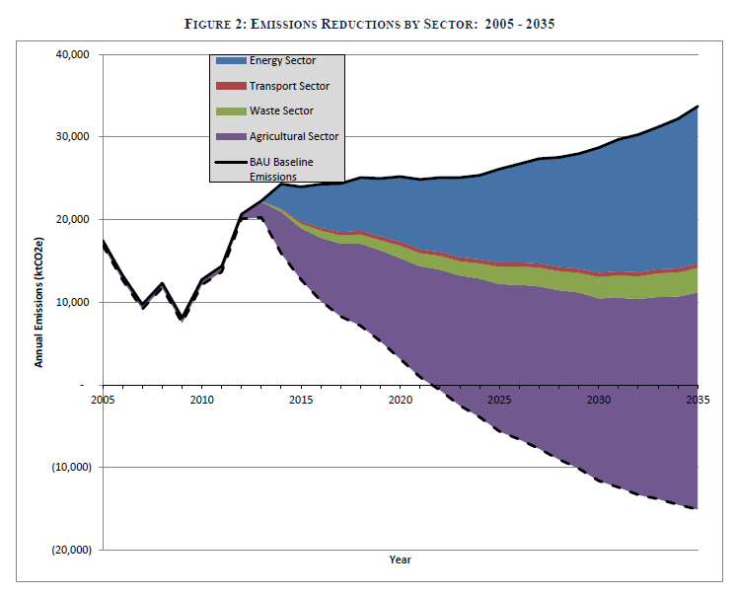
Low Carbon Growth for Uruguay
World Bank supported Low Carbon Growth study
The objective: To identify actions to reduce GHG emissions, estimating potential costs and volume of reductions. The focus will be on the agricultural and livestock sectors.
-Energy, Agriculture, Transport, Waste combined to depict national GHG emissions.
- Examination of mitigation measures across sectors
- Development of Marginal Abatement Cost Curves
Funded by:

Slide 15
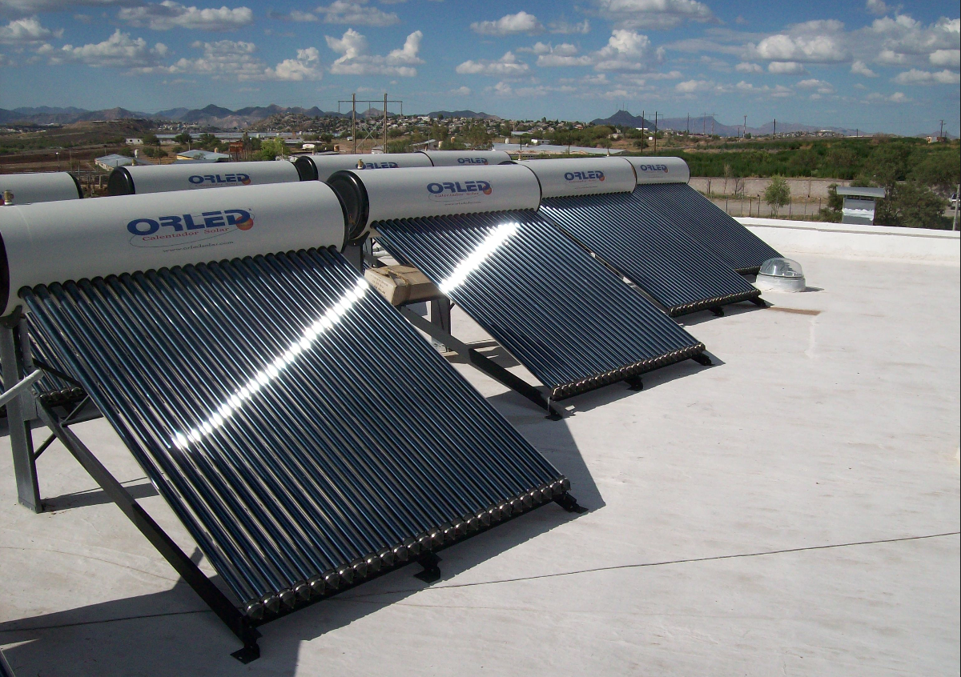
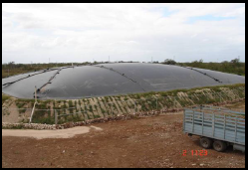
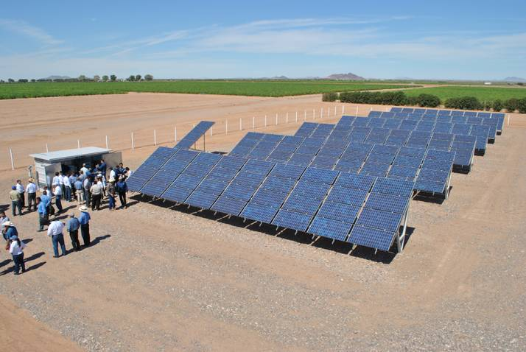
Mexico Sustainable Rural Development Project (FIRCO)
Mexico Sustainable Rural Development Project (FIRCO)
Project development
objective is to promote the
adoption of environmentally
sustainable technologies in
agri-businesses.
Technologies | Installed
Biodigestors | 342
Motogenerators - turbines | 183
PV connected to the grid | 323
Solar thermal | 146
Energy efficiency technology | 302
The global environment
objective of the project is to
promote the adoption of GHG
(CO2) emission-reduction
technologies by agribusinesses,
thus contributing to
the goals of the National
Strategy on Climate Change.
Tons of CO2 equivalent avoided: 3,805,940
Current installations for medium and large scale farms.
Next challenge: To bring technologies to smaller farmers
WB Loan 7652-MX: US $50.0 M (2009-2014)
GEF Grant TF-93134: US $10.5 M (2009-2016)
WB Loan 8216–MX: US $50.0 M (2014-2016)
Notes:
FIRCO Started in 2009
With the Objectives of
Currently has installed
Reduced GHG emissions
Small and medium
Next steps – larger farms

Slide 16
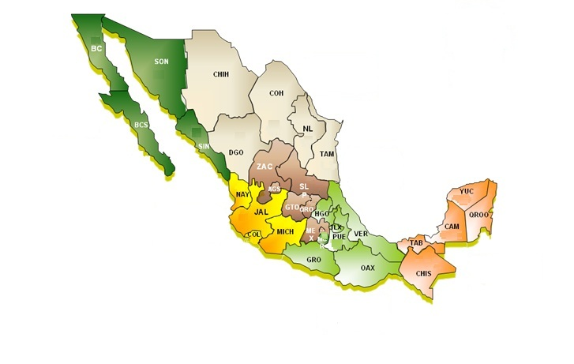
Mexico Sustainable Rural Development Project (FIRCO) –
technologies by region and type
North Region
327 Technologies
(28.61 %)
Northwest Region
117 Technologies
(10.24 %)
Central Region
285 Technologies
(24.93 %)
West Region
210 Technologies
(18.37 %)
Southeast Region
130 Technologies
(11.37 %)
South Region
74 Technologies
(6.47 %)
https://mapsengine.google.com/map/edit?mid=z__nWkMfrt7o.kObvkccf_B0c

Slide 17
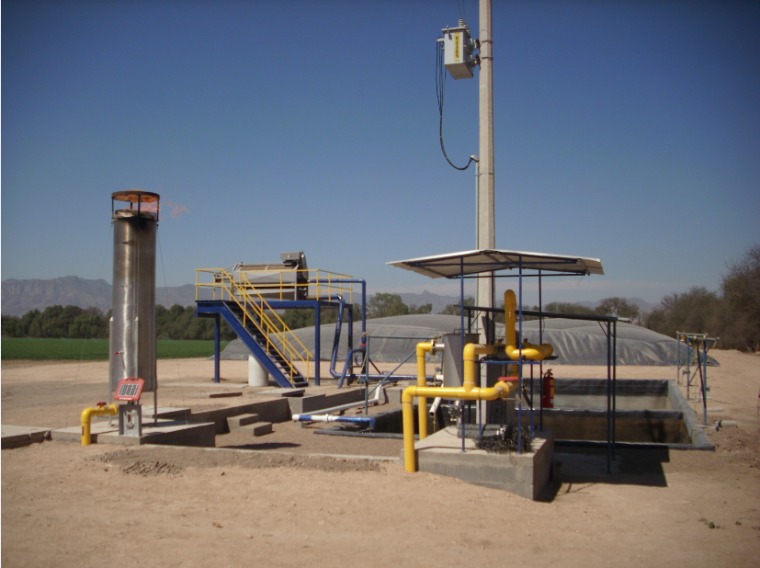
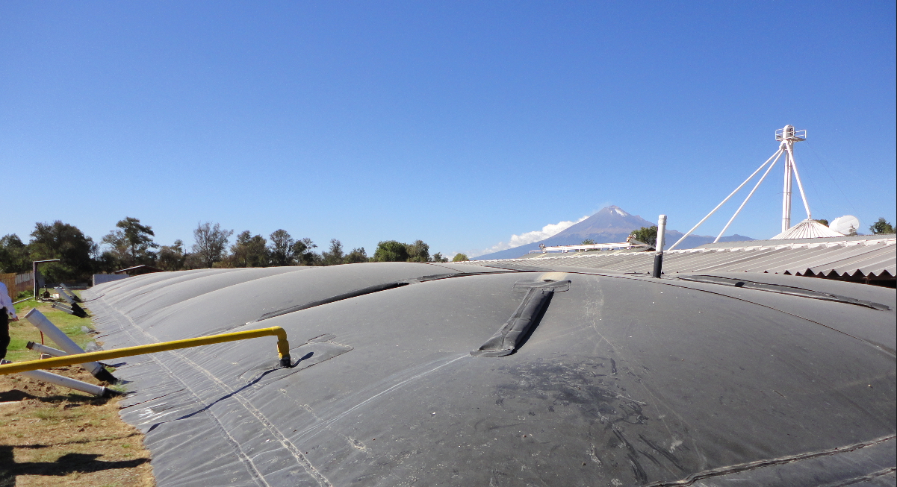
Biodigestors
Biogas used for thermal or electrical energy generation, mostly on pig and dairy farms
San Luis Potosí
Puebla

Slide 18
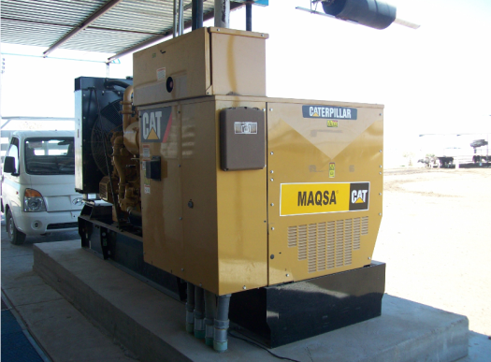
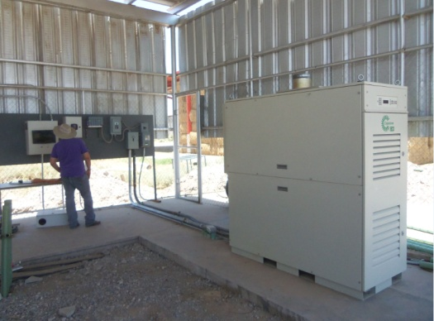
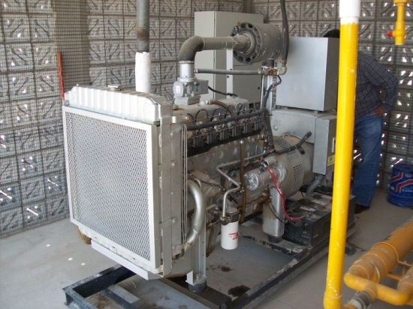
Motogenerators and Turbines
Complement to Biogas generation (motor-generators and turbines)
Potential for interconnected systems
Decreases Government subsidies to electricity

Slide 19
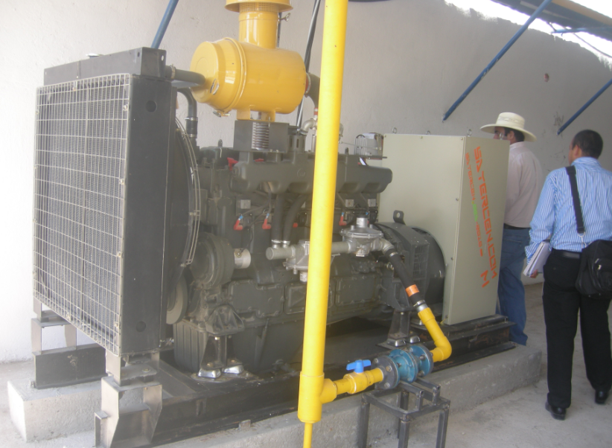
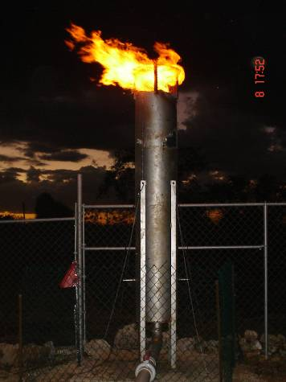
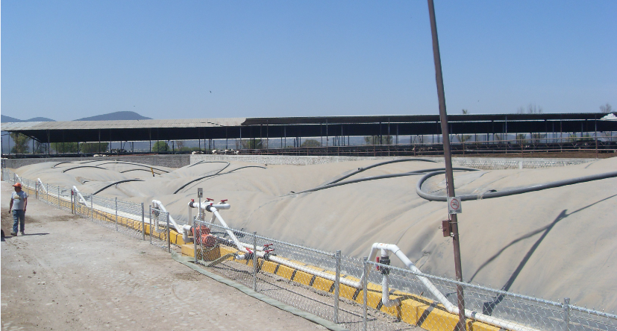
Boilers
Agricultural waste used in the production of electricity and thermal energy
Querétaro

Slide 20
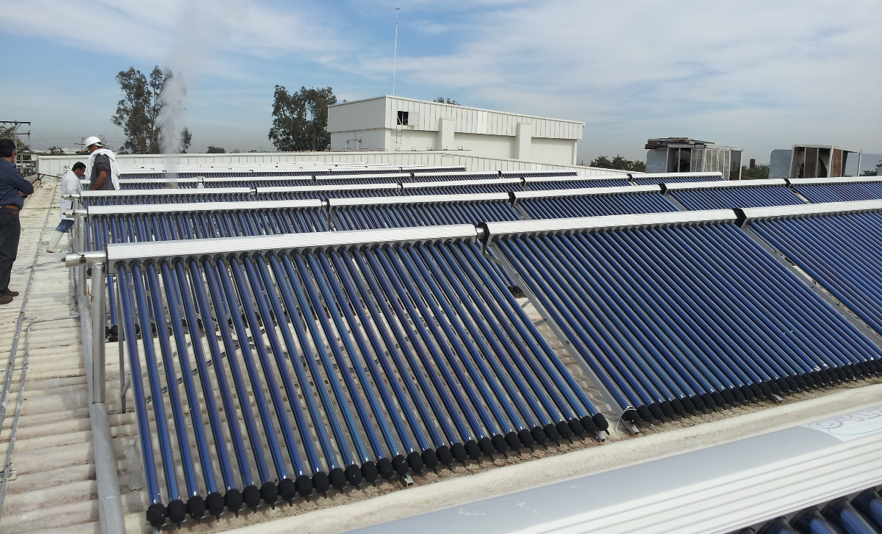
Solar Thermal
Transforms solar radiation into thermal energy, used to heat water for agricultural processes
Puebla
Hot water used in productive processes (boilers, sanitize facilities)
Decrease in fossil fuel consumption (40-70%), GHG reductions
Sinaloa
Chihuahua

Slide 21
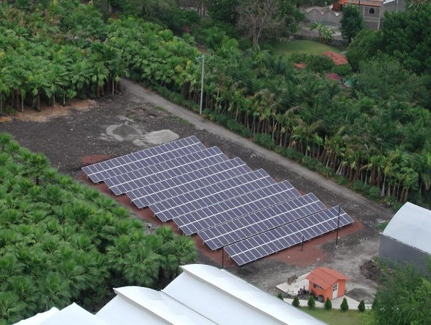
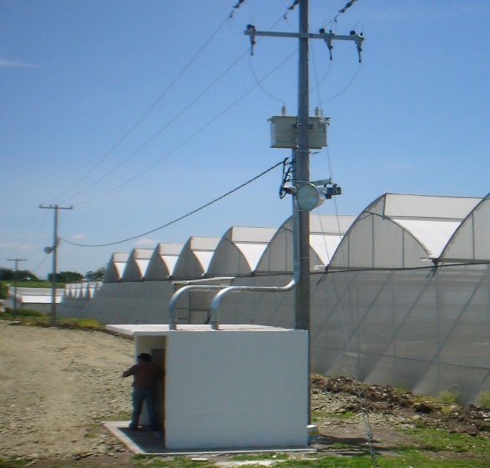
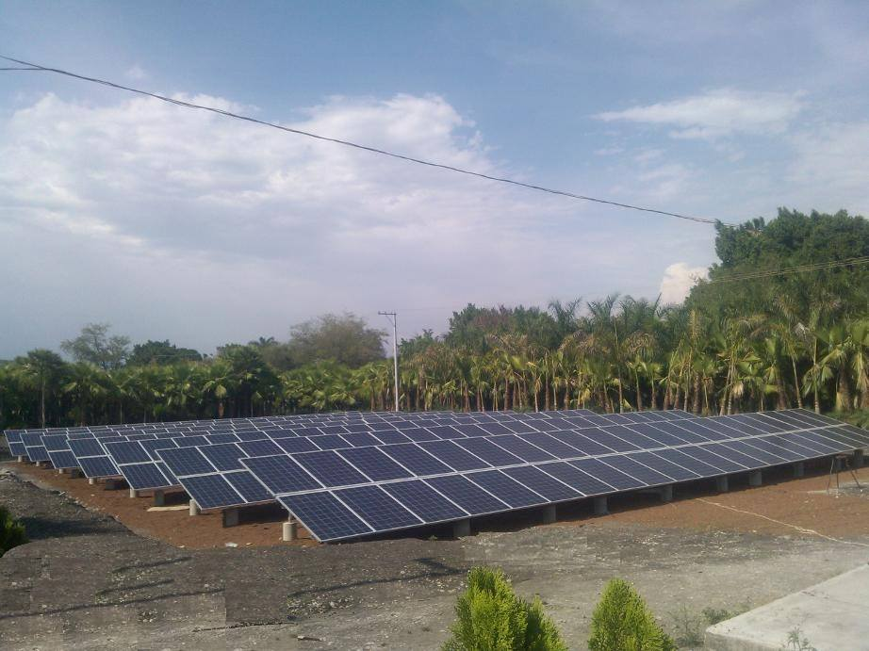
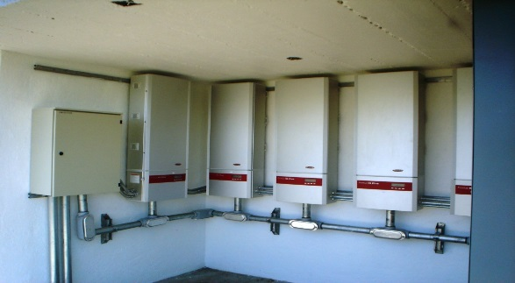
Grid-connected PV Systems
Photovoltaic systems convert sunlight directly into electricity.
Morelos
Sonora
Installed in agribusinesses with high electricity consumption
Reduced use of electricity from National Grid

